Slide 1

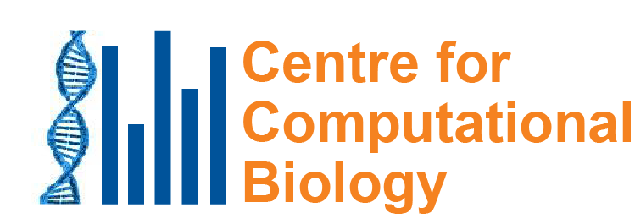
Mutational signatures: What caused the mutations in these cancers? Why do we care?
Steven G Rozen
steverozen@gmail.com
Duke-NUS Medical School, Singapore
InCoB 202
19th International Conference on Bioinformatics
Virtual meeting
2020 Nov 28 (35 min)
Notes:
25 minute talk

Slide 2
Outline
What are mutational signatures and what are they good for?
Computational analysis of mutational signatures – state of the art
Important questions in mutational signature analysis
Summary and next steps

Slide 3
What are mutational signatures and what are they good for? Example: Aristolochic acid

Slide 4
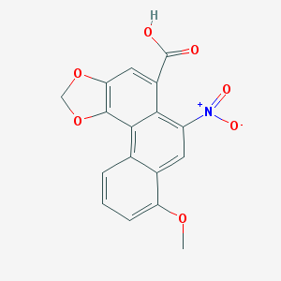
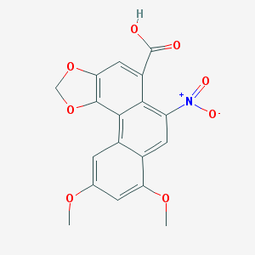
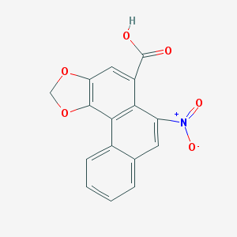
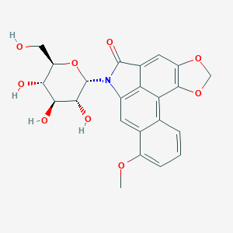
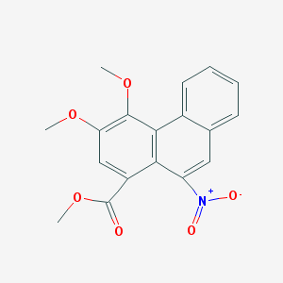
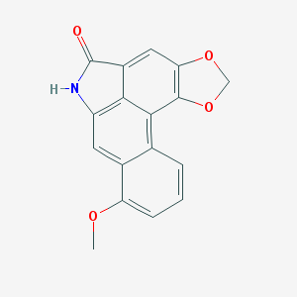
Aristolochic acids and relatives “AA”
Aristolochic acid I
Aristolochic acid II
Aristolochic acid IV
We will call them all “AA”
Aristolochic acid I studied intensively
Others very little
Aristolactam I, proximal mutagen
Aristolactam-N-beta-D-glycoside
Ariskanin A
Aristolochic acids (AAI – most studied, also AAII, AAIV, in many 关木通)

Slide 5
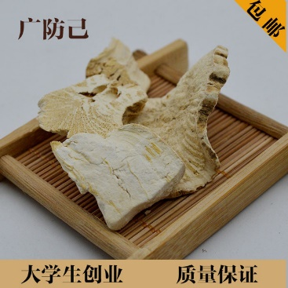
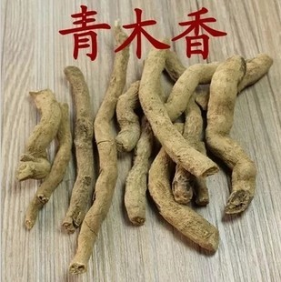
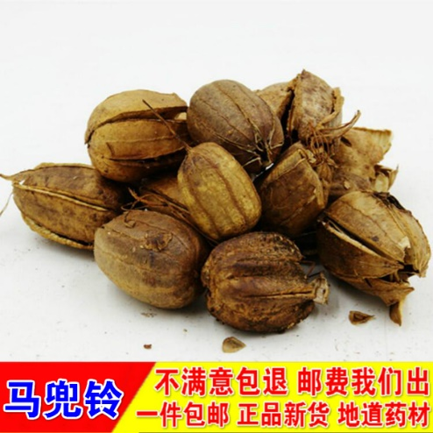
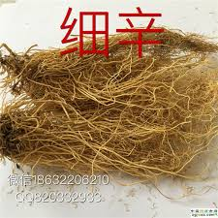
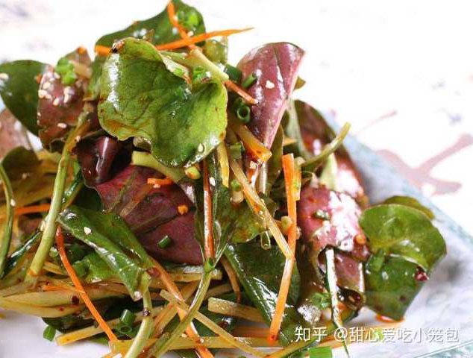
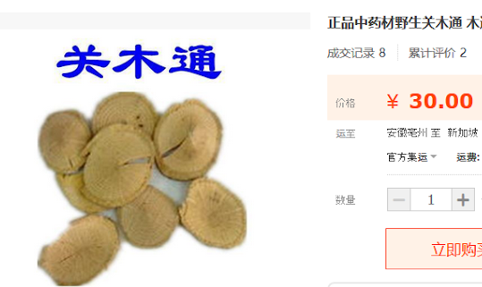
Plants with AA widely used as herbal medicine
(Occurs naturally in these plants)
Plants in Aristolochia and Asarum groups (genera), and perhaps other groups
鱼腥草

Slide 6
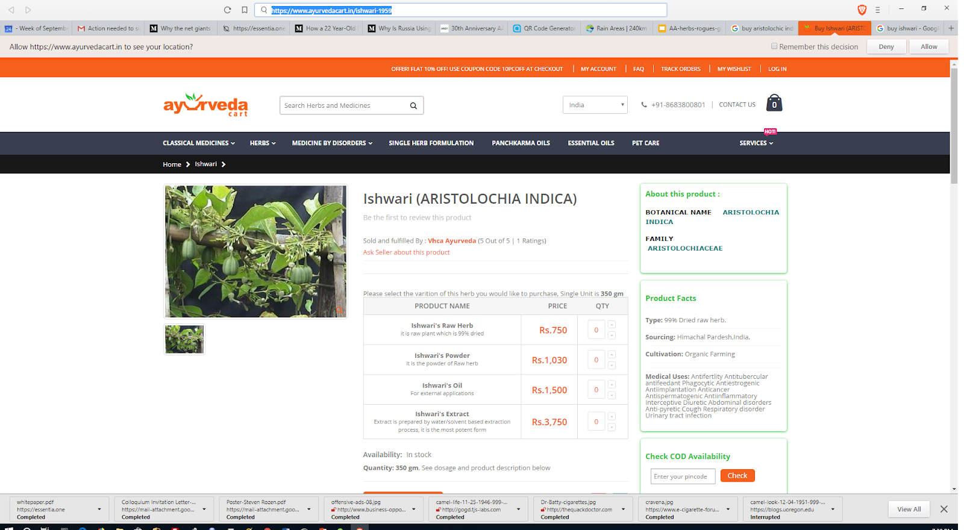
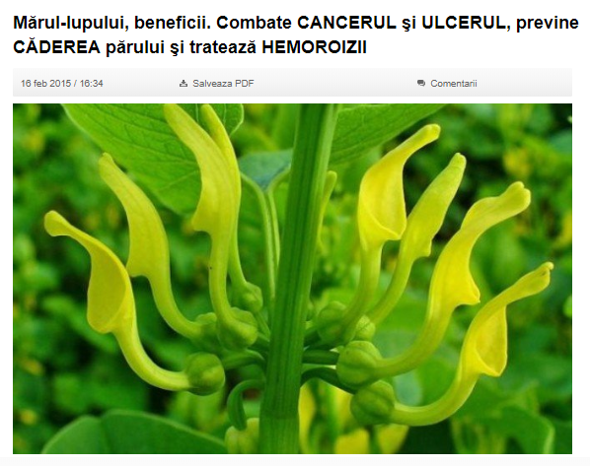
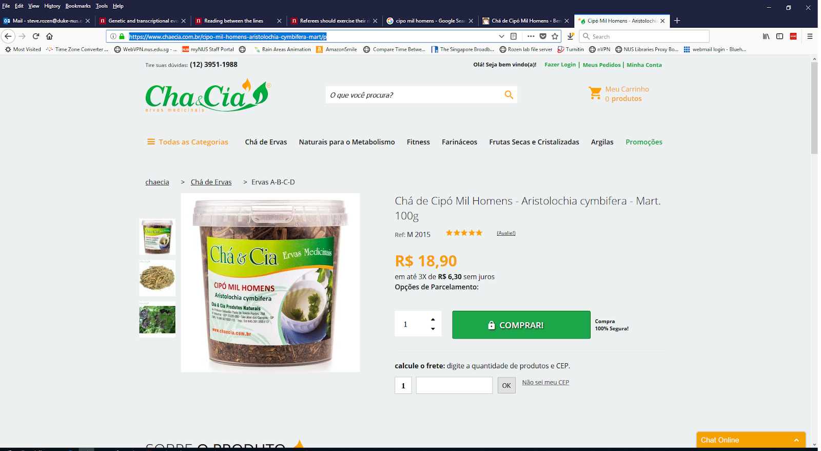
Not just Chinese herbal medicine
Romania
India
Aristolochia indica
Brazil
Aristolochia clematitis
Combats cancer, ulcers, prevents hair loss and hemorrhoids
Aristolochia cymbifera

Slide 7
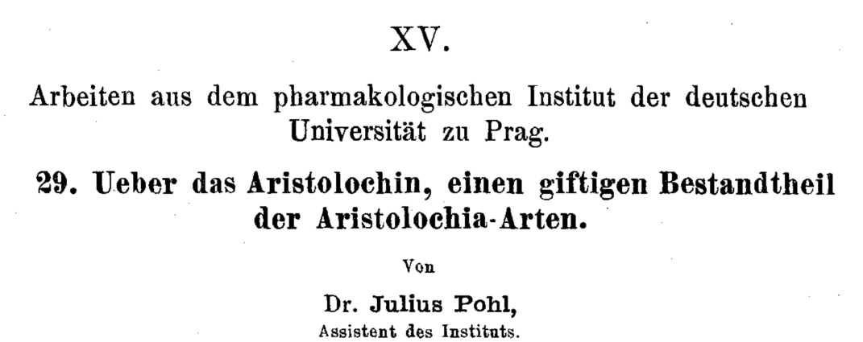
AA: well-known nephrotoxins
1891

Slide 8
1990s: AA emerges as a human health problem
~100 young women with end stage kidney disease
Single weight-loss clinic in Europe
汉防己, hàn fáng jǐ replaced by 广防己, guǎng fáng jǐ
Notes:
Dose: (Cosyns 2003; Nortier et al. 2000)
Adducts: Nortier et al., 2000

Slide 9
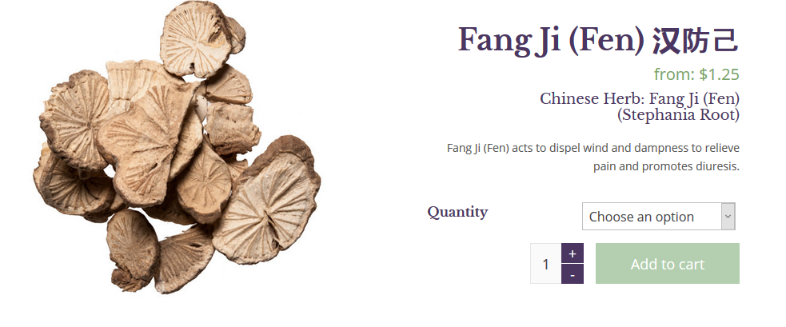
漢防己 / 汉防己, hàn fáng jǐ (genus Stephania – no AA)

Slide 10
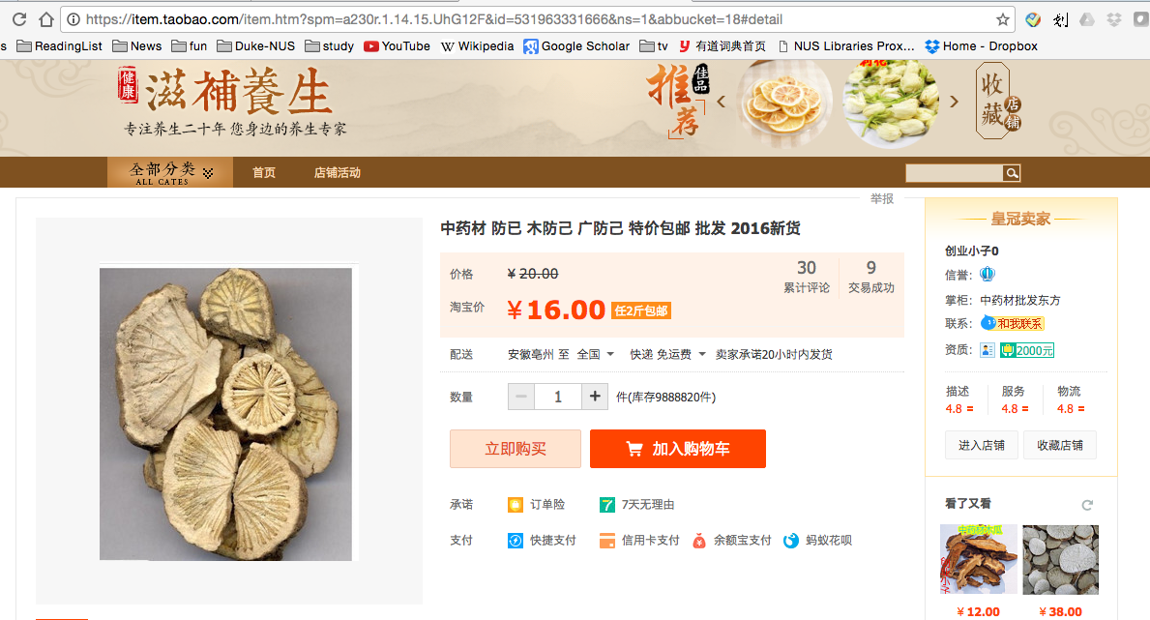
廣防己/广防己, guǎng fáng jǐ (genus Aristolochia – has AA)
Notes:
Total of 0.5 g over average of 13 months
AA adducts

Slide 11
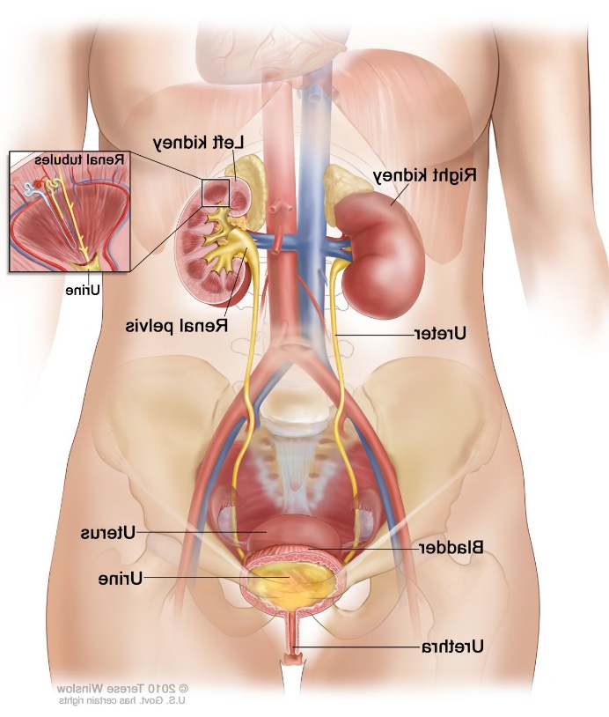
Many of the AA-kidney-failure victims developed upper tract urothelial cancer
(Nortier et al., 2000, NEJM)

Slide 12
Quick review: somatic mutations
Every time our cells divide, mutations arise
Mutations not present in the fertilized egg are somatic mutations
Focus on mutational signatures of somatic mutations

Slide 13
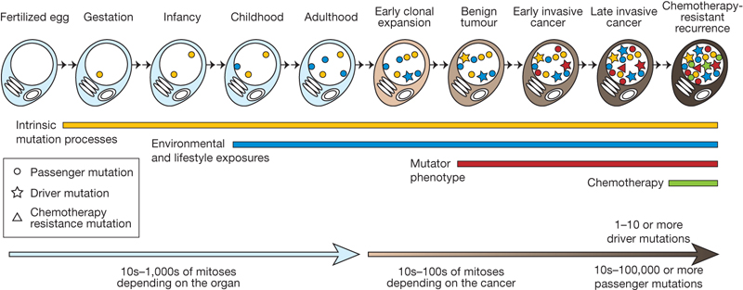
We detect somatic mutations by DNA sequencing normal cells and tumour cells
Normal
Normal
…ACGTCCTAGTCAAAATCGAGCC…

Slide 14
We detect somatic mutations by DNA sequencing normal cells and tumour cells
Normal
Tumour
…ACGTCCTAGTCAAAATCGAGCC…
…ACGTCCTAGTCTAAATCGAGCC…

Slide 15
We detect somatic mutations by DNA sequencing normal cells and tumour cells
We look for the variants found only in the tumor
Normal
Tumour
…ACGTCCTAGTCAAAATCGAGCC…
…ACGTCCTAGTCTAAATCGAGCC…
Somatic mutation from A > T
CAA > CTA trinucleotide context: information in neighboring bases

Slide 16
We look at all mutations (most are not causing the cancer; they are innocent bystanders)
We want to know: what mutated (changed) the DNA?
?

Slide 17
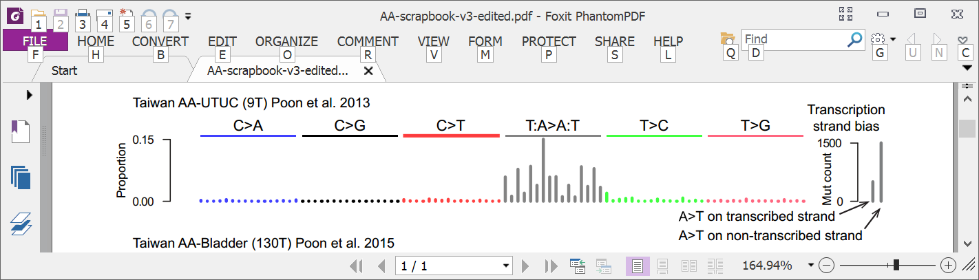
Mutational signature in an AA-exposed upper tract urothelial carcinoma
More
mutations
Each bar represents the total number of single nucleotide substitutions in a particular trinucleotide context
Highest bar represents the number of CAG to CTG mutations across the entire genome
The higher the bar, the more CAG to CTG mutations
Poon et al, Science Translational Medicine, 2013

Slide 18
Mutational signature in an AA-exposed upper tract urothelial carcinoma
More
mutations
AAG > ATG mutations
Not as many
Highest bar represents the number of CAG to CTG mutations across the entire genome
The higher the bar, the more CAG to CTG mutations
Mutations from C to A, C to G, C to T
Almost none
Poon et al, Science Translational Medicine, 2013

Slide 19
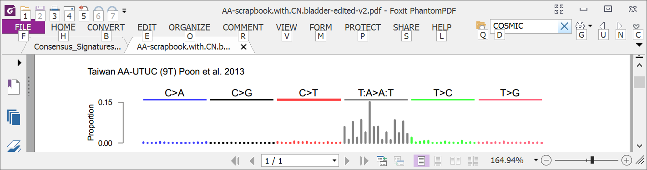
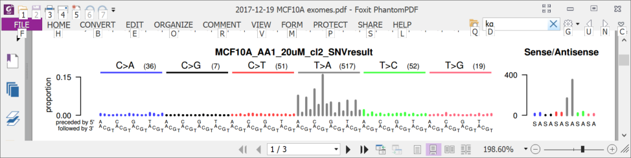
6 years ago (2013): AA in upper tract urothelial cancer and cell lines
Upper tract urothelial
AA exposed cell line
Poon et al., 2013, Hoang et al. 2013

Slide 20
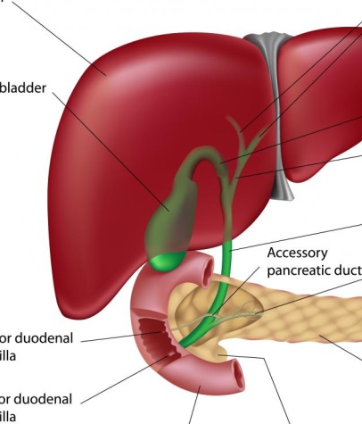
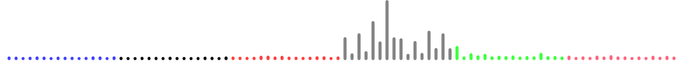
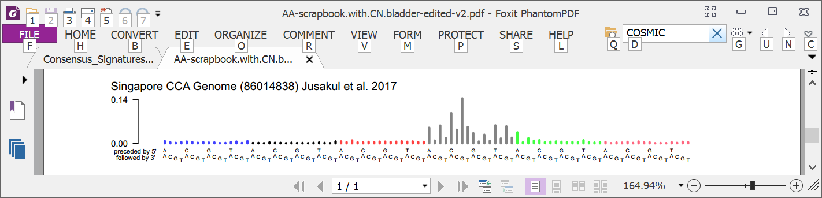
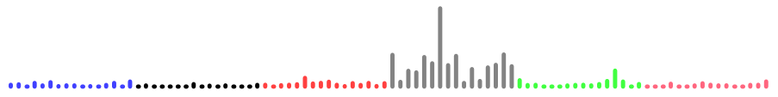
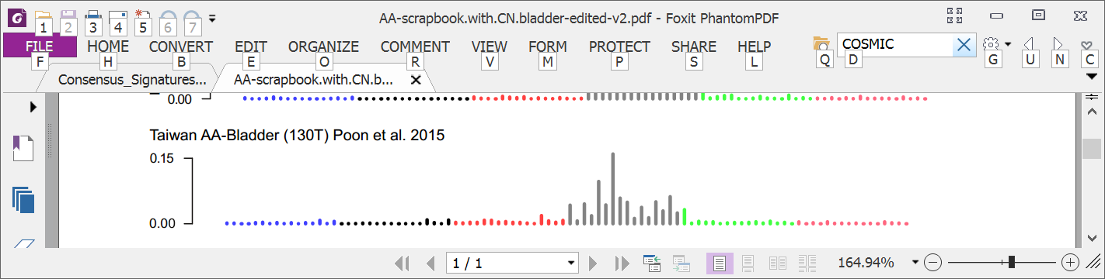
3 years ago: AA in multiple tumor types
Liver
Bile duct
Kidney
Upper tract urothelial
Bladder
Poon et al., 2013 and subsequent data (liver - hepatocellular carcinoma [HCC])
Zou et al., 2015, Jusakul et al., 2017 (bile duct carcinoma)
Scelo et al., 2014, Jelakovic et al., 2014 (kidney/renal cell carcinoma)
Poon et al., 2013, Hoang et al., 2013, many others (upper tract urothelial carcinoma)
Poon et al., 2015, others (bladder urothelial carcinoma)

Slide 21

Taiwan a known hotspot for AA exposure AA in liver cancer not studied
Chen, …., Grollman, PNAS, 2012
Map created by Freepik

Slide 22
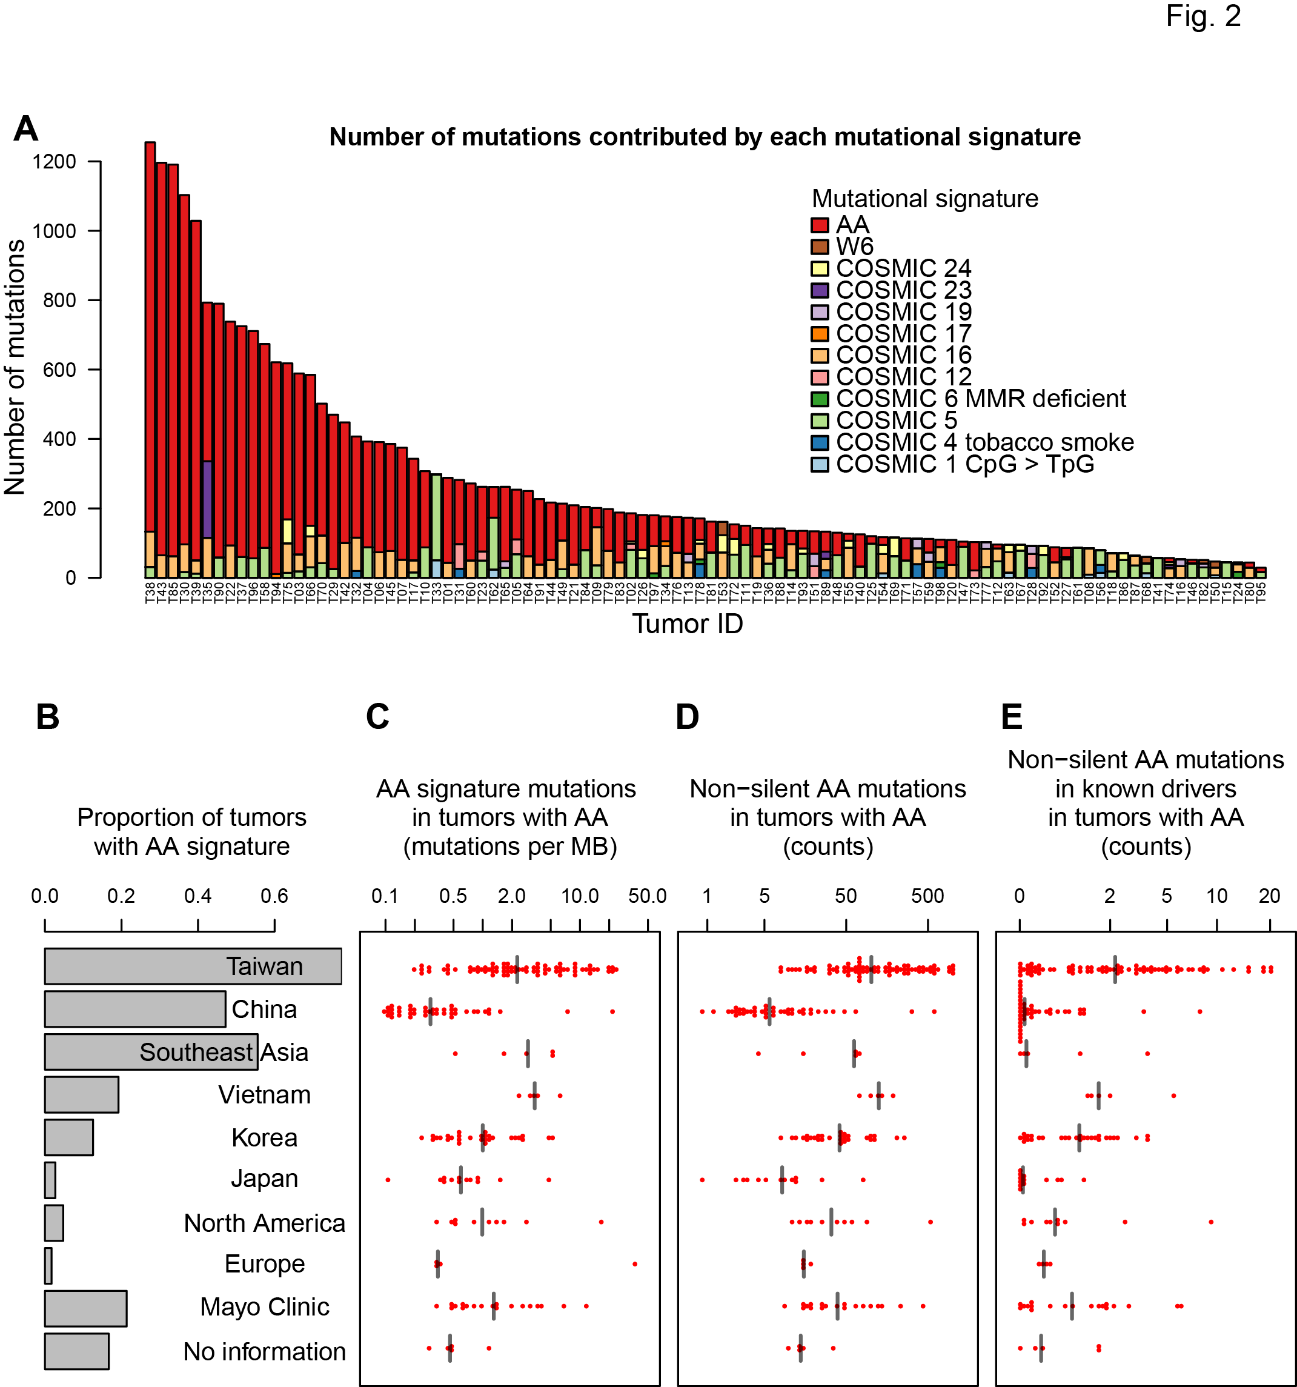
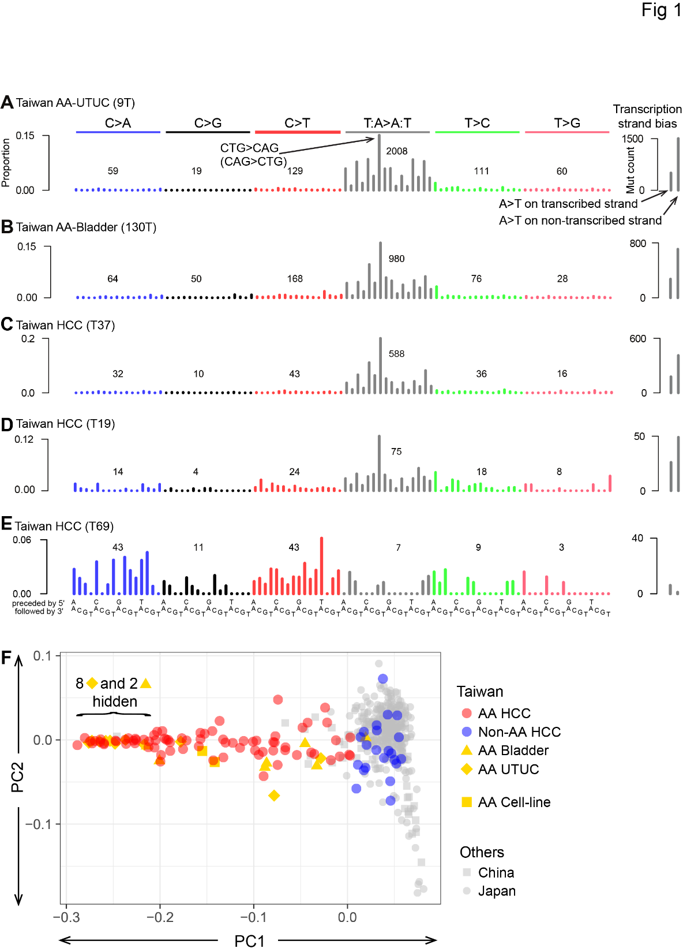
78% of Taiwan liver cancers (HCCs) had the AA signature
Ng, Poon, et al., Oct 2017 DOI: 10.1126/scitranslmed.aan6446

Slide 23
How extensive is AA exposure in > 1,600 liver cancers around the world?

Slide 24
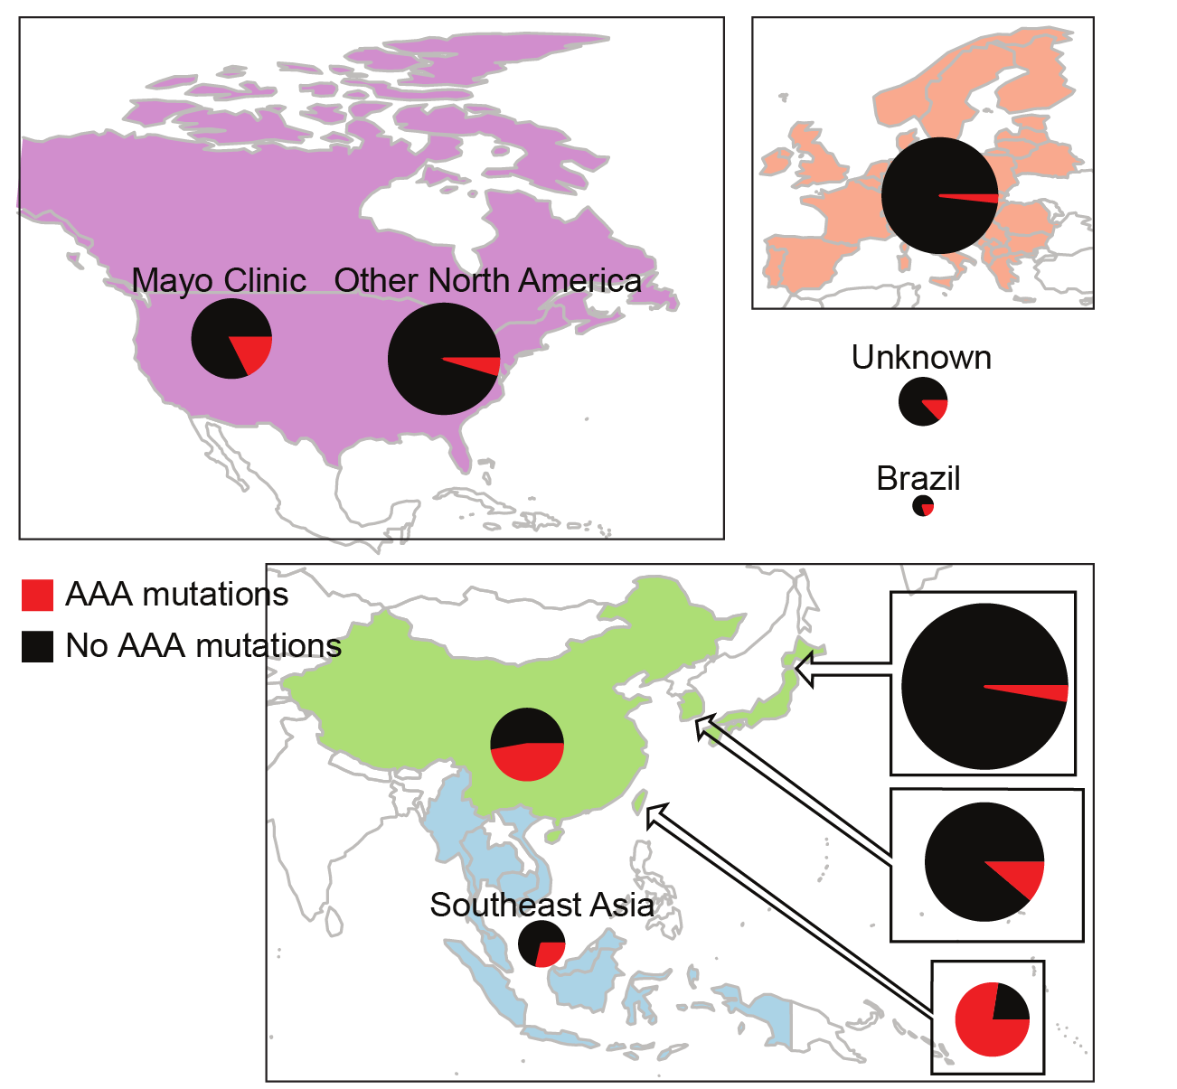
Prevalent AA exposure across > 1,600 liver cancers
“Asian” patients with no “country” – Overseas patients?
~50/100 (~50%) combined HCC and bile duct cancer in China
12/47 (25%) in Qidong (aflatoxin a major competing hazard)
Ng, Poon, et al., Oct 2017 DOI: 10.1126/stranslmed.aan6446 and subsequent publications; Zhang et al., 2017, Gastroenterology, 10.1053/j.gastro.2017.03.024; Xue et al., 2019, Cancer Cell,10.1016/j.ccell.2019.04.007

Slide 25
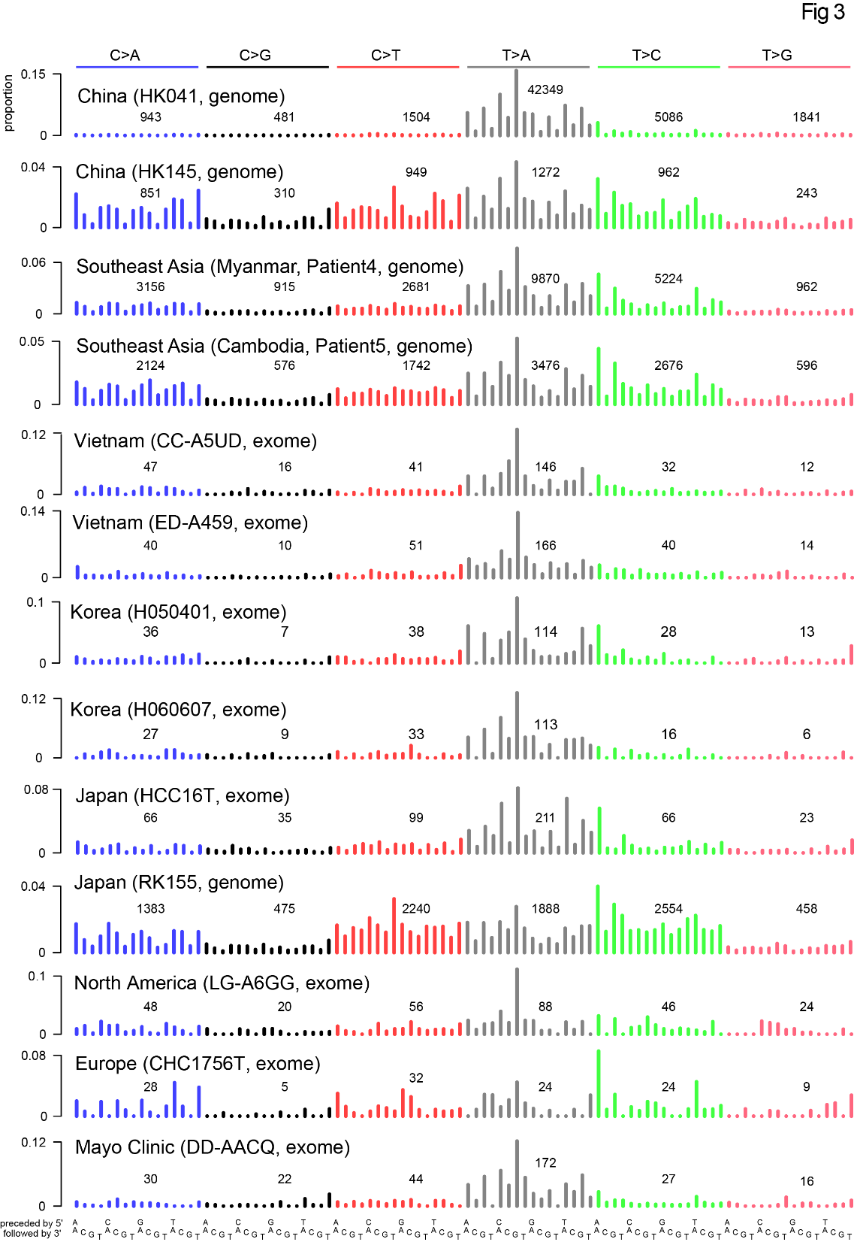

Slide 26
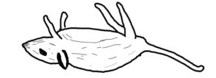
AA can cause liver cancer
Evidence…
Known mutagen and urinary tract carcinogen
“Asian” patients with no “country” – Overseas patients?
Multiple known cancer driver genes with AA mutations
Proportion of AA exposed liver cancers in Taiwan (78%) much greater than proportion of population exposed to AA herbs, (33%)
AA adducts liver tissue of HCC patients
~50/100 (~50%) combined HCC and bile duct cancer in China
Linear relationship between AA dose and risk of liver cancer in hepatitis-B-infected and hepatitis-C-infected patients
AA causes liver cancer in mice
12/47 (25%) in Qidong (aflatoxin a major competing hazard)
Ng, Poon, et al., Oct 2017 DOI: 10.1126/stranslmed.aan6446 and subsequent publications; Zhang et al., 2017, Gastroenterology, 10.1053/j.gastro.2017.03.024; Xue et al., 2019, Cancer Cell,10.1016/j.ccell.2019.04.007，Hsieh et al., 2008, 10.1186/1749-8546-3-13) Chen et al., 2018 (International Journal of Cancer, 10.1002/ijc.31544) Chen et al., 2019 (Cancer Epidemiology, Biomarkers & Prevention, 10.1158/1055-9965.EPI-19-0023），Lu et al. 2019 Hepatology, 2019, 10.1002/hep.30863 (mouse study)

Slide 27
Mutational signatures in research (Probably not needed)
Discovery
Analysis of large databases
Experimental elucidation
Mutational Signatures
Molecular cancer epidemiology
How do mutations cause cancer?
Understanding
DNA damage and repair
Prevention and screening
Cancer life histories and signature-associated oncogenic pathways
Application
Therapeutic opportunities

Slide 28
Computational analysis of mutational signatures: State of the art

Slide 29
What questions do we want to answer?
“Extraction” / Discovery Given a large number of spectra, what mutational signatures are present? (I.e. mutational signatures are latent variables to be discovered.) And how many mutations are caused by each extracted signature in each spectrum? (“Attribution”)
“Attribution only” Given known mutational signatures and one or more spectra, how many mutations in each spectrum were caused by each signature?
Other questions:
“Signature presence test” Given known mutational signatures, including a mutational signature of interest, what is the evidence that the signature of interest is present in a set of spectra spectra? Which spectra?
“Novel signature test” Given known mutational signatures and one or more spectra, what is the evidence that there is a novel signature present?

Slide 30
What questions to we want to answer?
“Extraction” / Discovery Given a large number of spectra, what mutational signatures are present? (I.e. mutational signatures are latent variables to be discovered.) And how many mutations are caused by each extracted signature in each spectrum? (“Attribution”)
“Attribution only” Given known mutational signatures and one or more spectra, how many mutations in each spectrum were caused by each signature?
Other questions:
“Presence Test” Given known mutational signatures, including a mutational signature of interest, and a single spectrum, what is the evidence that the signature of interest is present in the spectrum?
“Novel Signature Test” Given known mutational signatures and one or more spectra, what is the evidence that there is a novel signature present?

Slide 31
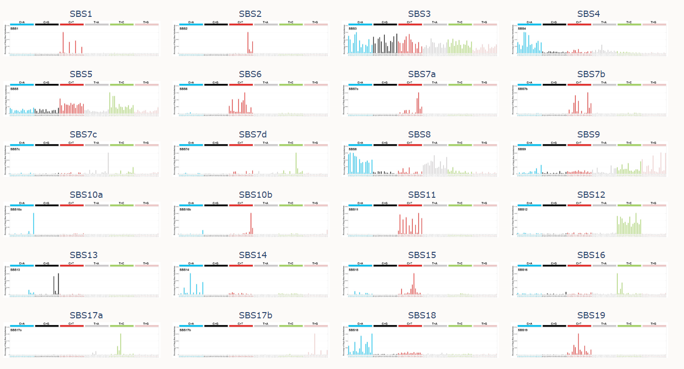
Why would you want to do signature extraction?
Many signatures have been extracted and confirmed by additional evidence
It is possible to estimate which known signatures are present in a spectrum or set of spectra
…
and many more
https://cancer.sanger.ac.uk/cosmic/signatures/index.tt

Slide 32
Why would you want to do signature extraction?
Many people will be more interested in
Assigning known signatures to their spectra
Determining if a specific signature is present or not in a given specturm
Determining if there a novel signature in their spectra
But, maybe
You are looking for new signatures in a new or expanded set of spectra
You think you have an approach for more useful delineation of signatures in existing data or for discovering previously overlooked signatures
You want to confirm previous extractions
You have new data and want to take an unbiased look at it before trying to match to previously described signatures
Warning: signature extraction will usually not work well on small sets of spectra
If you have a new, smallish set if spectra, may want to combine with existing data before doing signature extraction

Slide 33
Signature extraction – orientation

Slide 34
Sometimes a spectrum is dominated by 1 signature (Herbal medicine aristolochic acid mutations in multiple cancer types)
Liver
Bile duct
Kidney
Upper tract urothelial
Bladder
Poon et al., 2013 and subsequent data (liver - hepatocellular carcinoma [HCC])
Zou et al., 2015, Jusakul et al., 2017 (bile duct carcinoma)
Scelo et al., 2014, Jelakovic et al., 2014 (kidney/renal cell carcinoma)
Poon et al., 2013, Hoang et al., 2013, many others (upper tract urothelial carcinoma)
Poon et al., 2015, others (bladder urothelial carcinoma)

Slide 35
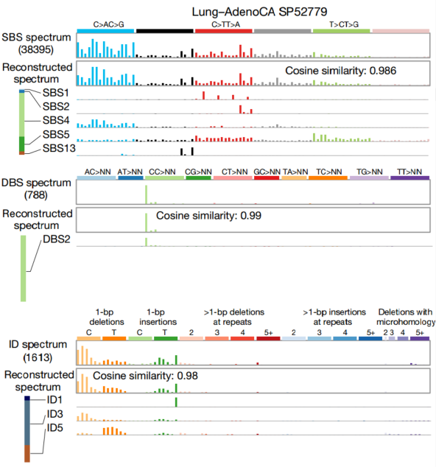
More often spectra are sums of the effects of multiple signatures
Lung adenocarcinoma
C>A C>G C>T T>A T>C T>G

Slide 36
We can tease apart signatures in large sets of spectra by data mining
Two mathematical approaches:
Approaches based on non-negative-factorization
Example, SigProfilerExtractor
Approaches based on probabilistic topic models
Example, an approach using hierarchical Dirichlet processes
These are unsupervised machine learning approaches
All methods seem to face similar challenges
Signature discovery is not a purely algorithmic process
The granularity of extracted signatures and the features considered depend on the larger questions you are considering

Slide 37
“All models are wrong but some are useful”
George E. P. Box (1979), "Robustness in the strategy of scientific model building", in Launer & Wilkinson, Robustness in Statistics
Mutational signatures are models
To assess the quality of mutational signature extraction, attribution, or presence testing, we need to consider the intended use
37

Slide 38
Signature extraction (discovery) Approaches based on Non-negative Matrix Factorization (NMF)

Slide 39
Many techniques for extraction are based on non negative matrix factorization (NMF)
Each cell contains level of exposure of 1 tumor to 1 signature
23,000 tumors
W
X
H
N
signatures
96 mutation types
23,000 tumors
N
signatures
≈
V (observed mutations)
96 mutation types

Slide 40
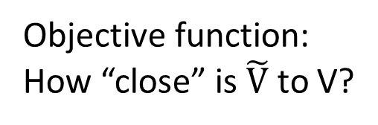

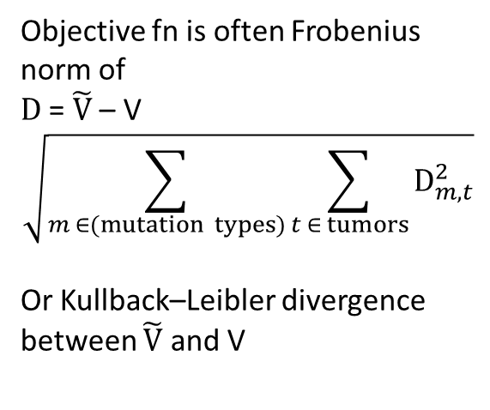
Many techniques for mutational signature extraction are based on non negative matrix factorization (NMF)
Each cell contains level of exposure of 1 tumor to 1 signature
Objective fn is often Frobenius norm of
D = $\tilde{V}$ – V
$$\sqrt{\sum_{m ∈(mutation types)}{\sum_{t ∈ tumors}{D_{m,t}^{2}}}}$$
Or Kullback–Leibler divergence between $\tilde{V}$ and V
23,000 tumors
W
X
H
N
signatures
96 mutation types
23,000 tumors
N
signatures
=
$\tilde{V}$ = W x H
96 mutation types
Objective function:
How “close” is $\tilde{V}$ to V?
≈
V (observed mutations)

Slide 41
General observations on NMF
NMF is a collection of algorithms and techniques
The best approximate factorization depends on the objective function
As for many unsupervised learning approaches, determining the number of items (signatures) to discover is challenging
Need to avoid overfitting (so often do multiple factorizations on e.g. bootstrapped data)

Slide 42
NMF case study: SigProfilerExtractor
Developed to supersede the MATLAB code used in Alexandrov 2013 and 2020
Part of a suite of software, other functions include:
SigProfilerMatrixGenerator (functionality overlaps ICAMS)
SigProfilerSingleSample
SigProfilerSimulator
Latest release: https://pypi.org/project/sigproextractor/
https://github.com/AlexandrovLab
Documentation at https://osf.io/t6j7u/wiki/3.%20Using%20the%20Tool%20-%20Output/
Under rapid development – details and algorithms may change

Slide 43
SigProfilerExtractor runs NMFs over multiple iterations of bootstrapped data
Purpose, to avoid overfitting
Multinomial resampling of counts for mutation types (e.g. ACA > AAA, ACC > AAC, … TTT > TGT) for each tumor based on the observed total mutation count in the tumor and the proportion of counts of each mutation type.
Recommends 100; user smaller number for initial testing
Recommend to run several times with different seeds; if solutions are different, run more NMF iterations
More info in Alexandrov et al 2013 and 2020:
http://dx.doi.org/10.1016/j.celrep.2012.12.008
https://doi.org/10.1038/s41586-020-1943-3

Slide 44
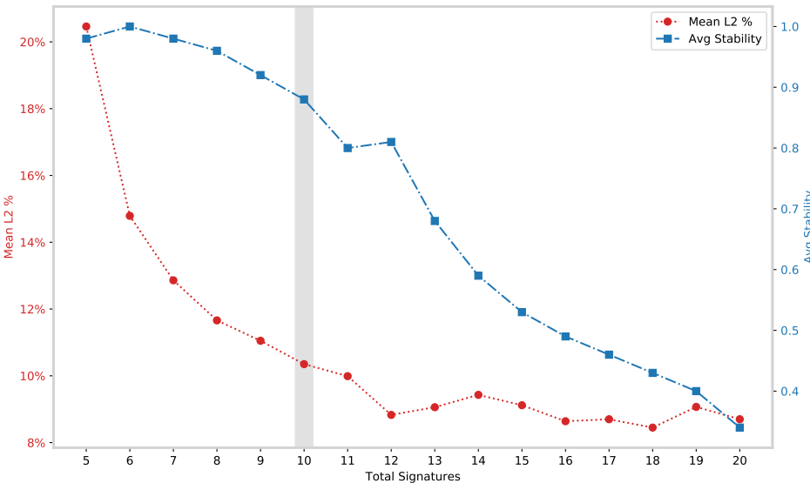
SigProfilerExtractor: Selecting the number of signatures
Mean L2% is the average across samples of the percent Euclidian reconstruction error (low is good)
Average stability is the mean across NMF iterations of silhouette coefficient of the clusters of proto-signatures (indicates how well the proto-signatures are clustered into signatures – high is good)
If Avg Stability is very jagged might try increasing the number of NMFs

Slide 45
Known issues with approaches based on non-negative matrix factorization (NMF)
The number of signatures is a judgement call (some approaches deal with this)
Weak signatures cannot be discovered in background of strong signatures
Signatures can be imperfectly separated (“bleeding” and “stealing” between signatures)
More generally, recovered signatures depend strongly on exact set of tumours studied
Lowest error reconstruction often involves many signatures, some with very low contributions, and often not biologically plausible (see following slides)
Signature discovery (extraction) is not a purely algorithmic process
In practice, discovering signatures (“extraction”) needs to be separated from estimating exposures (“attribution”)
!

Slide 46
Common misconception
Signatures that, when combined, give the most accurate reconstruction of a spectrum are the best ones

Slide 47
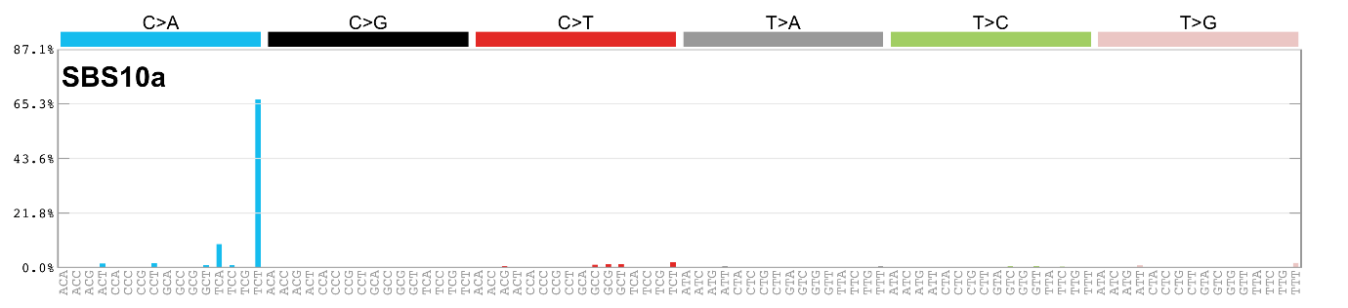
Extreme example:
A set of 96 signatures, each of one single base substitution in trinucleotide context will yield perfect reconstruction and zero biological insight

Slide 48
Signature discovery is not a purely algorithmic process: How to assess results (1)
The input data have been examined for sequencing and mapping artifacts (some which are well-known); mapped reads supporting unusual patterns have been examined in a read-alignment viewer or have been experimentally verified
Look for external supporting evidence
Correlation with known or expected mutagenic exposures, eg
cigarette smoking
Aflatoxins
AA-containing herbs
Haloalkanes
Age
UV radiation
Correlation with known or expected genetic causes, eg
polymerase epsilon proofreading defects
mismatch repair deficiency
homologous recombination repair deficiency (BRCA)
Can be tied to known biochemical processes (eg guanine adducts and signatures with C:G > N:N mutations)

Slide 49
Signature discovery is not a purely algorithmic process: How to assess results (2)
Association with genomic features that interact with DNA repair
Transcription strand bias
Replication strand / timing
Homopolymers (indels)
Look for supporting evidence within the data set
Samples dominated by a single signature
Signature is consistently deciphered from multiple independent datasets using different techniques or hyperparameters
Absence of known problems (next slides)
More info at https://static-content.springer.com/esm/art%3A10.1038%2Fs41586-020-1943-3/MediaObjects/41586_2020_1943_MOESM4_ESM.pdf, pages 6 & 7
Look for known issues with signature discovery

Slide 50
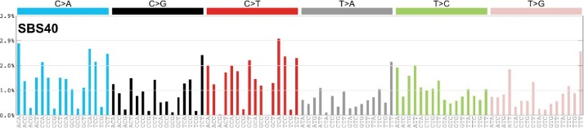
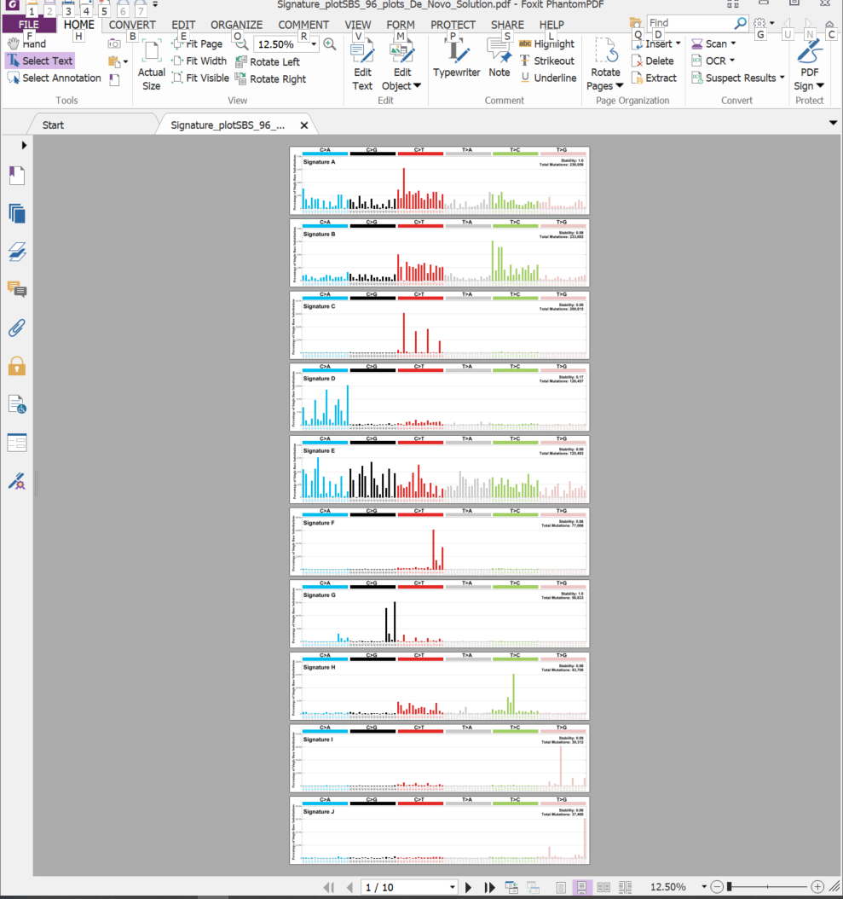
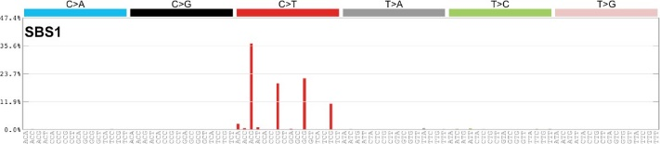
Known problems: bleeding
Ground truth (synthetic data)
Extracted
“Bleeding” or incomplete separation of some CG > TG mutations from SBS1 to SBS40-like extracted signature
50

Slide 51
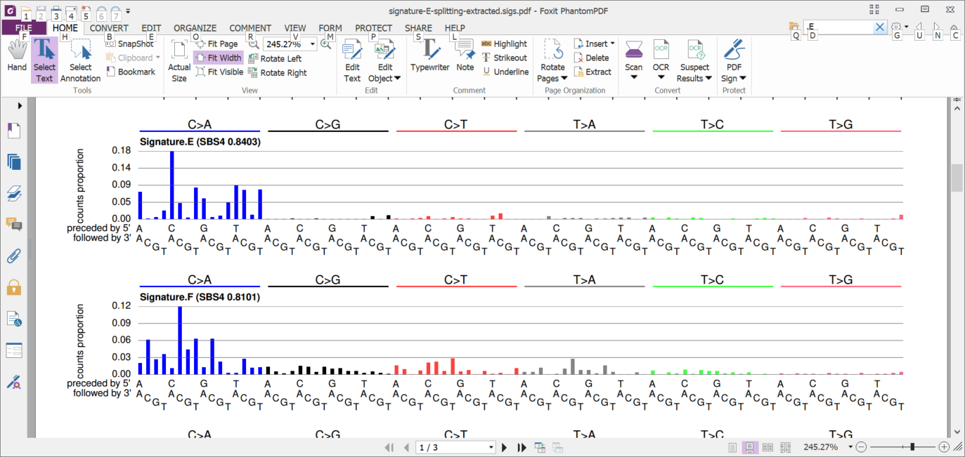
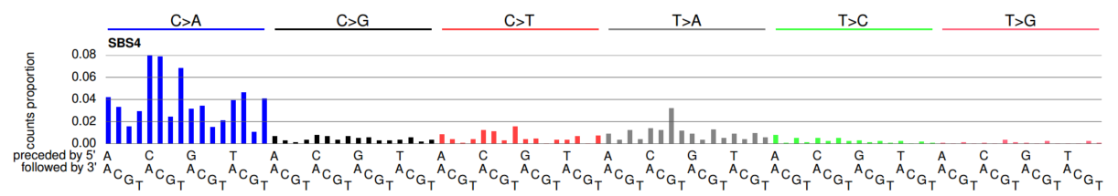
Known problem: over-splitting (from a different synthetic data set)
+
2 extracted signatures
≈
1 ground-truth signature

Slide 52
Important to think about why you are doing signature discovery
Are you trying to find novel signatures?
Are you trying to determine which signatures are present?
Or more likely, trying to determine which known signatures are present and if there are any novel signatures
Are you trying to estimate presence / absence or level of exposure to a particular signature, and perhaps tie these to clinical or population factors?
Some of these might be better and more easily conceptualized as signature attribution problems, rather than signature discovery problems (especially if only a small number of tumors or exome (as opposed to genome) data

Slide 53
Hierarchical Dirichlet processes (HDP) for mutational signature extraction / discovery
Inspired by a method for computing probabilistic topic models in text mining
Mutational signature discovery is isomorphic with discovering topics in probabilistic topic models
Mutation types (e.g. ACT > AGT) ~ words
Mutational signatures ~ topics
In probabilistic topic models, a topic is represented by the frequencies of occurrences of various words

Slide 54
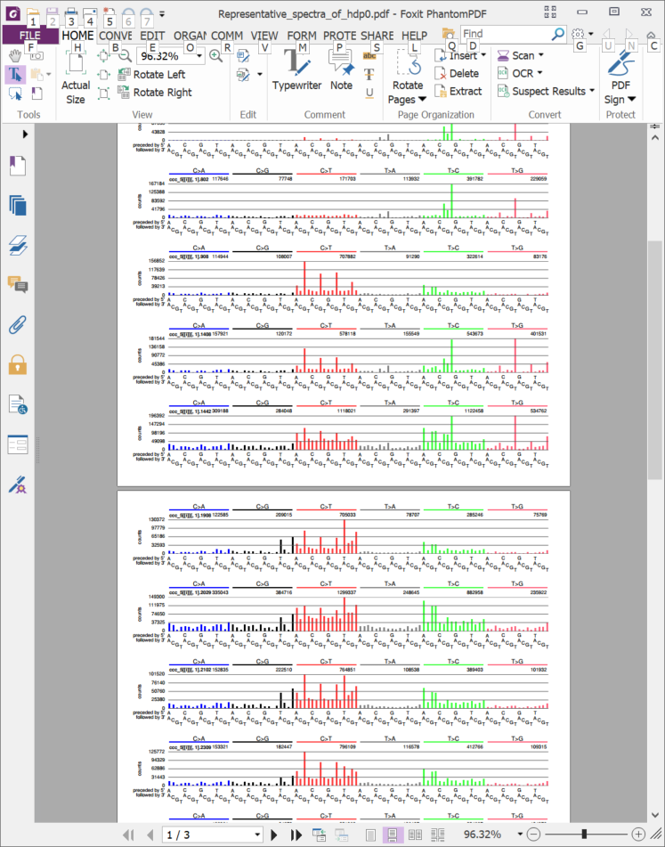
HDP for mutational signature discovery (1)
The conceptual focus is on assigning each mutation to a signature
The signature is a “raw cluster” of mutations generated by one abstract mutational process (which is modelled as a Dirichlet process)
The mutations are of different types (e.g. ACT > AGT, ACT > ATT, ….) , but they belong to the same raw cluster

Slide 55
HDP for mutational signature discovery (1)
The signature profile is obtained by dividing the number of mutations of each type in the raw cluster (“aggregated partial spectrum) by the total number of mutations in the cluster
The number of raw clusters (“aggregated partial spectra”) is not bounded a-priori, but is discovered by the model; however, it is influenced to some extent by the hyperparameters that are priors on the Dirichlet process concentration parameters
In plainer language, these govern how easily the model will postulate an additional raw cluster (which indirectly govern how easily the model will postulate a new mutational signature

Slide 56
The software for HDP as implemented by Roberts
Important: there are 2 phases to signature discovery
Part 1: Estimating “raw clusters” of mutations that approximate mutational signatures using a Gibb’s sampling method implemented by Teh
Tuning knobs: hyperparameters for the concentration parameters in the hierarchical Dirichlet process model (govern how easily it is to get a new raw cluster); parameters for the Gibb’s sampling including length of burnin and length of sampling chains; an initial guess of the number of raw clusters
Part 2: Aligning and merging raw clusters into signatures using clustering based on cosine similarity cutoffs and other parameters

Slide 57
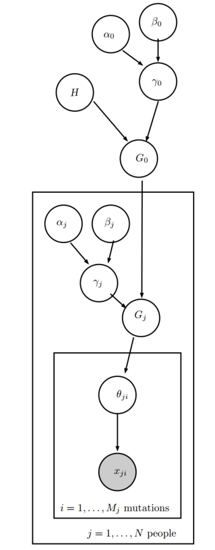
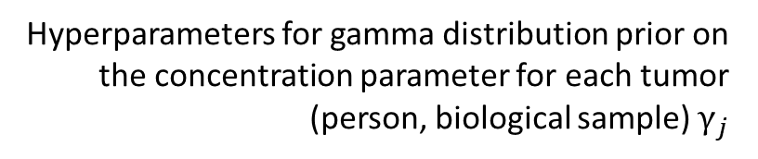
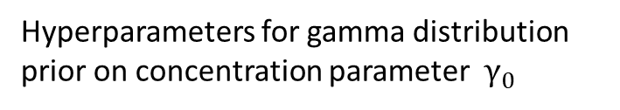
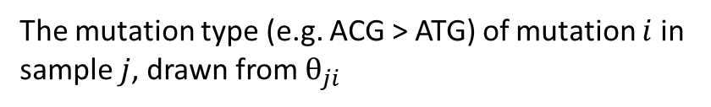

Part 1: Hierarchical Dirichlet process model for discovering mutational signatures
Hyperparameters for gamma distribution prior on concentration parameter $γ_{0}$
Uniform base distributions for signature profiles
Distribution of signatures drawn from a Dirichlet process with base distribution $H$ and concentration parameter $γ_{0}$
(Figure from Nicola Robert’s thesis)
Hyperparameters for gamma distribution prior on the concentration parameter for each tumor (person, biological sample) $γ_{j}$
Distribution of signatures drawn from a Dirichlet process with base distribution $G_{0}$ and concentration parameter $γ_{j}$
$θ_{ji}, t$he signature for mutation $i$ in sample $j$ (a signature is a categorical distribution over mutation types)
The mutation type (e.g. ACG > ATG) of mutation $i$ in sample $j$, drawn from $θ_{ji}$

Slide 58
Summary on data mining
Data mining for signature discovery (extraction) still evolving
We looked at two examples, SigProfilerExtractor and HDP
Both share some of the same issues, including the possibility of incomplete separation of signatures, over-separation of signatures (“over splitting”), and the related issue of determining the number of signatures
Both require dealing with some obvious and some not-so-obvious tuning parameters
Often researchers might be interested in more specific questions, such as
What known signatures are present in a set of spectra and how many mutations does each account for?
Are there novel signatures in a set of spectra?
Is a given signature present or absent in each of a set of spectra?
“Attribution” of known signatures (blue question above) is not well studied

Slide 59
Other important questions in mutational signature analysis

Slide 60
Important questions
What signature profiles are present in a large set of mutational spectra? (“Signature Extraction” already discussed)
What signatures contributed to a single mutational spectrum? (or a small set of related spectra) – “Signature Attribution”
What is the evidence that single signature (or group of signatures) contributed to a spectrum?
Is a spectrum adequately explained by the activities of known signatures? I.e., does my spectrum, or a group of related spectra contain a novel signature?

Slide 61
Important questions
What signature profiles are present in a large set of mutational spectra? (already discussed)
What signatures contributed to a single mutational spectrum? (or a small set of related spectra)
What is the evidence that single signature (or group of signatures) contributed to a spectrum?
Is a spectrum adequately explained by the activities of known signatures? I.e., does my spectrum, or a group of related spectra contain a novel signature?

Slide 62

Simply optimize coefficients of each signature to minimize reconstruction error (45 signatures assigned)

Slide 63

Impose some sparsity by requiring minimum number of mutations (30 signatures assigned)

Slide 64
Summary and next steps

Slide 65
Acknowledgements
Chang Gung Memorial Hospital
Sen-Yung Hsieh (谢森永)
Hao-Yi Huang
Ming-Chin Yu
Po-Huang Lee
Jacob See-Tong Pang
Singapore (Duke NUS, National Cancer Centre Singapore, and Johns Hopkins Singapore)
Arnoud Boot
Alvin NG Wei Tian (黄伟添)
Song Ling POON
Mi Ni HUANG
Jing Quan LIM
Nanhai Jiang
Shenli Zhang
Szu-Chi Ho
Willie Yu
Yuka Suzuki
Cedric C. Y. Ng
Patrick Tan
Bin Tean TEH
Alex Chang
Funding
Singapore National Medical Research Council
Singapore Ministry of Health via the Duke-NUS Signature Research Programmes
Chang Gung Medical Foundation

Slide 66
AA exposure is widespread in East Asia and causes liver cancer
More research is needed!
Thank you
steverozen@gmail.com
Main Taiwan HCC paper: https://tinyurl.com/aa-liver-cancer

Slide 67
The remainder are “backup slides”

Slide 68

DBPDE signature is slightly different (Dibenzo(a,l)pyrene-11,12-dihydrodiol-13,14-epoxide, anti-(+/-)-, CAS 153926-04-6 )
Clustered by Euclidian distance of all single base substituitons in trinucleotide context
Clustered by Euclidian distance of A:T > T:A substituitons in trinucleotide context

Slide 69
Table S6. Drivers identified by MutSigCV or 20/20+ in 98 Taiwan HCCs.
Gene | Proportion of Taiwan HCCs with mutation | Classification in Cancer Gene Census | Notes | Proportion with mutations in TCGA 2017
TP53 | 0.54 | TSG | Commonly mutated in HCC | 0.31
CTNNB1 | 0.24 | oncogene | Commonly mutated in HCC | 0.27
ALB | 0.21 |  | Commonly mutated in HCC, status as driver controversial | 0.13
AXIN1 | 0.17 | TSG | Commonly mutated in HCC | 0.08
DOCK8 | 0.11 |  | Not expressed in liver or liver cancer (http://www.proteinatlas.org/ENSG00000107099-DOCK8/cancer); not observed in any other HCC genomic study | NR
BRD7 | 0.09 |  | Observed in Totoki et al., 2014 , Fujimoto et al., 2016 | NR
ARID2 | 0.09 | TSG | Observed in multiple other HCC genomic studies | 0.05
RPS6KA3 | 0.08 |  | Observed in multiple other HCC genomic studies | 0.04
IRF2 | 0.06 |  | Reported as an HCC TSG in Guichard et al., 2012 | NR
RAG1 | 0.06 |  | Activation of immunoglobulin V-D-J recombination.; not likely to have a role in hepatocytes or liver cancer | NR
RB1 | 0.06 | TSG | Observed in multiple other HCC genomic studies | 0.04
PBRM1 | 0.05 | TSG | Observed in multiple other HCC genomic studies | NR

Slide 70

M. Heinrich et al 2009
doi:10.1016/j.jep.2009.05.028

Slide 71

Proposed AAI metabolism, from Viktoriya Sidorenko slide deck “Liver-kidney organs-on-a-chip reveal distant site for bioactivation of human carcinogen”

Slide 72
Conceptual context
Statistical and computational analysis
Experimental study of causes of mutational signatures
Mutational Signatures
New understanding
of DNA damage and repair
Molecular cancer epidemiology
How do mutations cause cancer?
Prevention and screening
Cancer life histories and signature-associated oncogenic pathways
Specific therapeutic opportunities

Slide 73


Variable and diverse AA content
Each column is a sample
关木通 guān mù tōng (stem of
Aristolochia manshuriensis)
High concentration
Each row is a different AA analog
Low concentration
Michl et al., 2015, J. Natural Products doi:10.1021/acs.jnatprod.5b00556
Notes:
https://www.e138.net/zhongyao/cai-141.html

Slide 74

Details of kidney damage from AA
Important: Leads to cancer
Many patients with AA kidney failure develop urothelial cancer
(Nortier et al., 2000, NEJM)
Untreated
Upper tract (near kidney)
Normally rare
90 days after AA
exposure
Inflammatory infiltration
Urothelial dysplasia
Glomerulus: ischemic shrinkage
Tubule with naked basement membrane (necrotic epithelium)
Poon, 2013, doi:10.1126/scitranslmed.3006086
400X, scale bar: 25 μm
Notes:
mouse kidney (hematoxylin and eosin staining, ×400; scale bars, 25 um)
day 10,: accumulation of proteinaceous fluid within the tubules of the AA-treated kidney (*)
days 30 and 90: tubular epithelial cells were necrotic and had collapsed, leaving the tubular basement membrane naked (#). There were few signs of regeneration.
The glomeruli demonstrated ischemic shrinkage (arrowhead).
Dat 90 local inflammatory infiltration (arrow) in the interstitium,
urothelial dysplasia had developed
(50 mg/kg) for 3 days
Cosyns: intraperitoneal 0.1 mg AA/kg/day 5/7 days during 17 (N 5 5) and 21 (N 5 6)
Estimated dose in Belgium? In he *powder* it was up to 2.9 mg / g – see Identification of aristolochic acids in Chinese herbs. Lancet 1994;343:174 ??? Cannot find
From Dickman review: “The maximal daily dose of AA ingested by the cluster of Belgian women is estimated to be 0.025 mg kg1 body weight daily for an average of 13 months (Cosyns 2003; Nortier et al. 2000), “

Slide 76
Number of AA mutations was variable
AA signature mutations
in tumours with the signature
(mutations per megabase)
2.26 AA mutations / Mb
Taiwan
Mainland China
Other SE Asia
Vietnam
Korea
Japan
North America
Europe
Mayo Clinic
No information
0.29 AA mutations / Mb

Slide 77
Number of AA-mutated cancer driver genes was variable
Nevertheless…
Overall, many tumors had AA mutations in known cancer driver genes
AA signature mutations
in tumours in known driver genes
(counts)
Taiwan
Mainland China
Other SE Asia
Vietnam
Korea
Japan
North America
Europe
Mayo Clinic
No information
Taiwan: 2 AA mutations in known cancer drivers
Mainland: only a few with 1 AA mutation in known cancer driver gene

Slide 78


AA causes liver cancer in mice
** or * indicate
significant
versus untreated
The mutational features of aristolochic acid-induced mouse and human liver cancers
Zhao-Ning Lu, Qing Luo, Li-Nan Zhao, Yi Shi, Xian-Bin Su,
Ze-Guang Han
doi: https://doi.org/10.1101/507301
Dec 28, 2018
Months after exposure
7.5 15 35 70
Total dose (mg/kg)
(Re-drawn from Lu et al.)

Slide 79
Mutational signature in an AA-exposed upper tract urothelial carcinoma
More
mutations
More
mutations
AA exposed cell line
Poon et al, Science Translational Medicine, 2013
Notes:
Cel line: MCF10A_AA1_20uM_cl2_SNVresult from Arnoud 2018 09 21

Slide 80
Outline
AA compounds in herbal medicine
AA mutational signature and urothelial cancer
AA in liver cancer
Ongoing research and summary

Slide 81

Variable and diverse AA content
Each column is a sample
天仙藤 tiān xiān téng (thin stems and leaves of Aristolochia debilis)
High concentration
Each row is a different AA analog
Low concentration
Michl et al., 2015, J. Natural Products doi:10.1021/acs.jnatprod.5b00556

Slide 82





Preliminary results: Several AA related compounds have similar mutational signatures
AA I
AA I in MCF10A cells
Liver cancer
AA D
AA D in HepG2 cells
AA D in HepG2 cells (replicate)
hydroxy
methoxy

Slide 83


Preliminary results: Several AA related compounds have similar mutational signatures
AA I
AA I in MCF10A cells
Liver cancer
Aristolactam I

Slide 84


Preliminary results: Several AA related compounds have similar mutational signatures
AA I
AA I in MCF10A cells
Liver cancer
Aristolactam BII

Slide 85


More AA signatures: Double-base signatures in exposed cell lines and in tumours
AA I
Taiwan
upper-tract
urothelial
carcinoma
Clues regarding damage and repair and AA-caused oncogenic mutations

Slide 86


More AA signatures: Deletion signatures in exposed cell lines and in tumours
AA I
Taiwan
upper-tract
urothelial
carcinoma
Clues regarding damage and repair and AA-caused oncogenic mutations

Slide 87
Main results
Liver mutation data indicate widespread exposure to AA
AA: known urinary tract carcinogen and kidney toxin
AA-mutated liver cancers are common in many parts of East Asia
AA herbs are also used in South Asia, Africa, and Latin America, but AA exposure in cancer there has not been studied
Multiple lines of evidence, including epidemiological and experimental studies, provide strong evidence that AA causes liver cancer
Multiple AA-related compounds generate the same mutational signatures

Slide 88
Evidence that this signature
Liver cancer
is due to AA
Identical AA signatures in cell lines

Slide 89
Evidence that this signature
Liver cancer
is due to AA
Identical AA signatures in cell lines
No other known exposure creates this signature
Mutational spectra of many tumours dominated by this signature (the signature is often easy to detect by inspection – see above)
Signature associated with aristolactam-DNA adducts: kidney cancer, upper tract urothelial carcinoma, intra-hepatic bile duct cancer, HCC (aristolactams are the directly mutagenic metabolites of AA)
Found in tumours in geographic regions with known high exposure to AA
Epidemiological evidence that consumption of AA-containing herbs increases HCC risk in region where high proportion of HCCs have this signature

Slide 90
Future research leading to prevention
What is the dose-risk relationship between AA exposure and liver cancer? In conjunction with hepatitis?
How are people being exposed? Which herbs? How prepared? Which AAs are they being exposed to?
Which AA-family chemicals and dosages have the main impact on kidney failure, urinary tract cancer, and liver and bile duct cancers?

Slide 91

AA causes liver cancer in mice
The mutational features of aristolochic acid-induced mouse and human liver cancers
Zhao-Ning Lu, Qing Luo, Li-Nan Zhao,
Yi Shi, Na Wang, Lan Wang,
Ze-Guang Han
Hepatology, 2019, 10.1002/hep.30863
** or * = significant versus untreated
Tumor incidence (%)
Months after exposure
AAI @ 2.5 mg/kg or 5 mg/kg (“high”)
Notes:
3 X AAI = 7.5 14 X AAI = 35 high X 3= 15

Slide 92
Slides on attribution – not needed

Slide 93
Attribution and problems with attribution: The need to consider all available evidence

Slide 94
Central techniques based on non negative matrix factorization (NMF)
Each cell of H contains the number of mutations in 1 tumor due to 1 signature
23,000 tumors
W
X
H
K
signatures
96 mutation types
23,000 tumors
K
signatures
≈
V (observed mutations)
96 mutation types
Each cell of V contains the number of mutations of 1 type (e.g. CTG > CAG) in 1 tumor

Slide 95
For Attribution: Fix the signatures, fit the exposures by standard constrained linear optimization approaches
Solve for the exposures
W
96 mutation types
X
N
signatures
H
N
signatures
≈
96 mutation types
V (observed mutations)
Fix the signatures
Very few
tumours

Slide 96
Sparsity and plausibility
Signatures that, when combined, give the most accurate reconstruction of a spectrum are the best ones
Adding more signatures in tiny amounts usually improves reconstruction even if activity of signatures is biologically implausible
Not useful for deciding if a mutational signature is present to a biologically meaningful extent

Slide 97

Lack of sparsity: every signature is in (almost) every tumor A problem in earlier the predecessors of SignatureProfiler
Real MMR deficient
tumors
Attribution of MMR signature improves reconstruction of spectra but is useless for understanding biology
Alexandrov, 2013
Signature 6 (dark red) is a signature of mismatch repair (MMR) deficiencty
(microsatellite instability) in colon tumors
Almost every tumor has Signature 6, but in reality most colon tumors do NOT have MMR deficiency

Slide 98
Lack of sparsity (close up)
Alexandrov, 2013

Slide 99




Extracted signatures good match to ground truth (6 of 11 shown)
Ground truth
Extracted

Slide 100

SigProfilerExtractor attribution example SBS40
Inference
Truth

Slide 101

SigProfilerExtractor attribution example SBS5
Inference
Truth

Slide 102

SigProfilerExtractor attribution example SBS1
Inference
Truth

Slide 103
General issues with attribution
Not studied very thoroughly
With enough signatures, adding more signatures almost always improves reconstructions
Issues of sparsity (tiny exposures to many signatures)
Issues of biological plausibility
Common examples:
ultraviolet signatures in tumors with no possibility of UV exposure
Single base substitution signatures of microsatellite instability in tumors that clearly do not have microsatellite instability
Signatures of defective polymerase epsilon proofreading (which generates very high numbers of mutations) with very low mutation counts (and no defect in the polymerase epsilon gene).

Slide 104
Summary so far
Discussed signature extraction (data mining) and attribution
Showed approach to generate synthetic data
Extraction and how to assess results in context
Determining number signatures is central
Attribution and how to assess results in context
Example of a non-negative matrix factorization approach, SigProfilerExtractor
Attribution examples from SigProfiler
Signature discovery and attribution are not purely algorithmic activates; they require assessment of all available evidence
Challenges are generic, not restricted to SigProfiler (to be covered in Part 2 of this lecture)

Slide 105
HDP not used

Slide 106

Part 1: Computing over the hierarchical Dirichlet process model (1)
Gibb’s sampling over the “Chinese restaurant franchise” representation of the hierarchical Dirichlet process (details outside the scope of this tutorial)
Each sampled point contains two important matrices
1. The number of mutations of each mutation type (e.g. ACT > AGT) in each raw cluster (“aggregated partial signature”, variable “classqq”)

Slide 107
Each of these is a “raw cluster” a.k.a. “aggregated partial spectrum” sampled at one point on the Gibb’s sampling chain
This is a raw cluster that is capturing mutations due to SBS17b
Note very large counts (e.g. 2,383,673). This is because this raw cluster capture SBS17b mutations across a set of 900 spectra

Slide 108

Part 1: Computing over the hierarchical Dirichlet process model (2)
Gibb’s sampling over the “Chinese restaurant franchise” representation of the hierarchical Dirichlet process (details outside the scope of this tutorial)
Each sampled point contains:
1. The number of mutations of each mutation type (e.g. ACT > AGT) in each raw cluster (“aggregated partial signature”, variable “classqq”)
2. The number of mutations in each raw cluster in each tumor (proto-exposures / attributions “classnd”)

Slide 109
Each cell is the count of mutations assigned to one raw cluster (at one point in the sampling chain)
Raw clusters

Slide 110
Part 1: Computing over the hierarchical Dirichlet process model (3)
Gibb’s sampling over the “Chinese restaurant franchise” representation of the hierarchical Dirichlet process (details outside the scope of this tutorial)
Each sampled point contains:
The number of mutations of each mutation type (e.g. ACT > AGT) in each raw cluster (“aggregated partial signature”, variable “classqq”)
The number of mutations in each raw cluster in each tumor (proto-exposures / attributions “classnd”)
The output is the sampled distributions of these
The pragmatics are that you need to run a burnin of the Gibb’s sampling chain, because the initial guess of the model parameters might be far from the true values
There are diagnostics to help determine when the burnin is sufficient – basically the distributions of the model need to stabilize

Slide 111


Diagnostics on burnin
Bad
Good
Burnin iterations
Burnin iterations

Slide 112

Part 2 Aligning and merging raw clusters to estimate mutational signatures
At each point in Gibb’s sampling chain the number of raw clusters (“aggregated partial spectra”) can vary
Therefore the raw clusters have to be aligned along the sampling chain, i.e. raw cluster 23 has to be the same at each sampled point in the chain
Sometimes clusters appear and disappear along the chain

Slide 113
Part 2 Aligning and merging raw clusters to estimate mutational signatures
There can be multiple independent sampling chains (e.g. run on different cores); clusters need to be merged across chains
Then very similar clusters still need to be merged
Some merged raw clusters are “noise” and are relegated to “signature 0”

Slide 114


Allocation of mutations to signature (“component”) 0 seems to needs work; this seems to affect attribution, but not the accuracy of extracted signatures We think we can fix this
Number of mutations
Number of mutations
Good
Bad
Extracted mutational signature
Extracted mutational signature

Slide 115

In synthetic data, often, except signature 0, all signatures very close to ground truth
Nearly perfect extraction of SBS3
Signature 0, a mixture of ground truth signatures SBS1, SBS5, SBS17a, SBS17b
Nearly perfect extractions of SBS5, SBS8, SBS9

Slide 116
Component 0 contains a mixture of ground truth signatures partly because of raw clusters (“aggregated partial spectra”) in the sampling chain that represent mixtures of ground truth signatures

